Slide 1
Module 4
Going Global

Slide 2
Outline
1. MODULE 4 INTRODUCTION
  Introduction to Going Global
2. AWS GLOBAL INFRASTRUCTURE
  Choosing AWS Regions
  Diving Deeper into AWS Global Infrastructure
  Infrastructure and Automation

Slide 3
Introduction to Going Global
You've been introduced to some foundational elements of the AWS Global Infrastructure, such as AWS Regions and Availability Zones (AZs).
In the following lessons, you will learn even more about AWS infrastructure.
Concepts covered in these lessons include how to choose a Region, the value of edge locations, and how to use services such as AWS CloudFormation to streamline and automate deployment.
In addition to achieving high availability, these components of the AWS Global Infrastructure can help your business achieve benefits like elasticity and agility.

Slide 4
In this lesson, you will learn:
Review basic components of the AWS Global Infrastructure.

Slide 5
Selecting AWS Regions
When choosing a Region or set of Regions for your workloads, consider:
  Proximity to end users – reduces latency.
  Compliance requirements – meet local data residency laws.
  Service availability – some AWS services are Region-specific.
  Cost factors – pricing varies by Region.
  Disaster recovery & redundancy – deploy across multiple Regions for resilience.

Slide 6
AWS Edge Locations
Provide localized delivery of frequently accessed content.
Reduce latency by caching static resources (e.g., images, videos).
Support AWS services like Amazon CloudFront for content delivery and Route 53 for DNS resolution.

Slide 7
Infrastructure as Code (IaC) with AWS CloudFormation
Automates the deployment and management of AWS resources.
Ensures consistent and repeatable configurations across environments.
Enables version control and infrastructure change tracking.
Supports scalable, reliable global deployments.

Slide 8
Infrastructure as Code (IaC)
Infrastructure as Code is the practice of managing and provisioning IT infrastructure (servers, networks, databases, etc.) through machine-readable configuration files instead of manual setup.
Benefits:
  Consistency – avoids configuration drift.
  Repeatability – deploy the same environment multiple times.
  Automation – speeds up deployment and reduces errors.
  Version control – store infrastructure definitions alongside application code.

Slide 9
AWS CloudFormation
CloudFormation is Amazon’s IaC service that lets you define and provision AWS infrastructure using JSON or YAML templates.
Key Features:
  Template-based deployment – describe resources (like EC2, S3, VPC) in a file.
  Automatic provisioning – AWS creates, updates, and deletes resources for you.
  Stack management – group resources into “stacks” that can be managed as a unit.
  Integration – works with most AWS services.

Slide 10
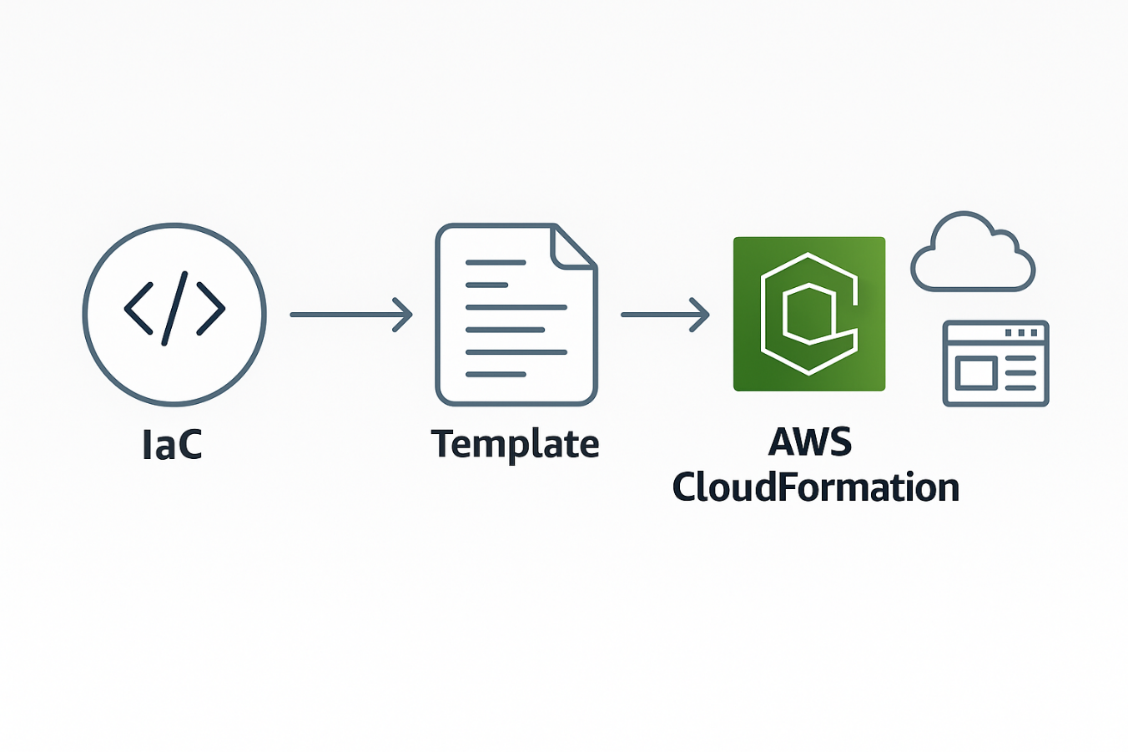
In Short
IaC is the concept of defining infrastructure through code.
CloudFormation is AWS’s implementation of IaC.

Slide 11
Choosing AWS Regions

Slide 12
In this lesson, you will learn:
Describe how to choose a Region.

Slide 13
Choosing an AWS Region
When choosing a Region, evaluate:
  Compliance
    Ensure your Region choice aligns with local data governance and regulatory requirements.
    Example: Financial data in Frankfurt must remain in Germany; data stored in China must remain within Chinese borders.
    For example, the General Data Protection Regulation (GDPR) is designed to protect the personal data and privacy of individuals within the European Union (EU).
  Proximity to Customers
    Deploy resources close to your primary user base to reduce latency and improve performance.
    Example: If customers are in Singapore, using the Singapore Region will improve response times.
  Feature Availability
    Not all AWS Regions have every service or feature.
    New AWS services are rolled out to Regions over time; check that the Region supports the services you need.
  Pricing
    Service costs vary between Regions due to factors like taxes and energy costs.
    Review AWS pricing pages to compare operational costs per Region.

Slide 14
Diving Deeper into AWS Global Infrastructure

Slide 15
In this lesson, you will learn:
Describe key benefits of using multiple Regions and Availability Zones.
Define edge locations.
Describe and differentiate between Regions, Availability Zones, and edge locations.

Slide 16
Key elements of AWS Global Infrastructure
AWS Regions
  Regions are geographical areas around the world that are made up of multiple data centers.
  These data centers provide scalable and redundant infrastructure for hosting cloud services.
  Each Region consists of multiple, isolated locations known as Availability Zones. Each Region has three or more Availability Zones.
Availability Zones
  Availability Zones are distinct locations within a Region, each designed as an independent zone with its own power, networking, and connectivity.
  Availability Zones maintain high availability and fault tolerance for applications. Each Availability Zones consists of one or more data centers.
Edge locations
  Edge locations are strategically placed sites around the world that cache content to deliver data, video, and applications with lower latency and higher transfer speeds.
  Edge locations are considered a vital part of the AWS content delivery network (CDN) and use services like CloudFront to efficiently distribute data to end users.

Slide 17
AWS Global Infrastructure – Redundancy & Edge Services
Redundant Architectures
  Multi-AZ (Availability Zone) Deployments
    Each AWS Region contains multiple isolated AZs.
    Distribute resources across AZs for high availability and business continuity.
    Benefits:
      Seamless failover in case of an AZ outage.
      Reduced latency.
      Enhanced disaster recovery.
      Support for compliance requirements.
  Multi-Region Deployments
    Deploy applications across multiple AWS Regions.
    Enables regional failover in case of an entire Region outage.
    Provides additional disaster recovery and global performance benefits.

Slide 18
Edge Services for Content Delivery & Performance
Amazon CloudFront
  Global Content Delivery Network (CDN).
  Delivers data, videos, applications, and APIs with low latency and high transfer speeds.
  Uses worldwide Edge Locations for faster access to cached content.
Amazon Route 53
  Scalable Domain Name System (DNS) web service.
  Routes users to the nearest and best-performing endpoints.
  Translates human-readable domain names into IP addresses.
AWS Outposts
  Extends AWS services and infrastructure to on-premises locations.
  Useful for workloads requiring ultra-low latency or local data processing.

Slide 19
Infrastructure and Automation

Slide 20
In this lesson, you will learn:
Describe the key features and benefits of CloudFormation.
Identify use cases for programmatic access, the AWS Management Console, and infrastructure as code.

Slide 21
CloudFormation
CloudFormation is a service that helps you model and set up your AWS resources so that you can spend less time managing those resources and more time focusing on your applications that run in AWS.
With CloudFormation, you can define your infrastructure as code (IaC).
You create a template that describes all the AWS resources that you want (like Amazon Elastic Compute Cloud (Amazon EC2) instances), and CloudFormation takes care of provisioning and configuring those resources for you.

Slide 22
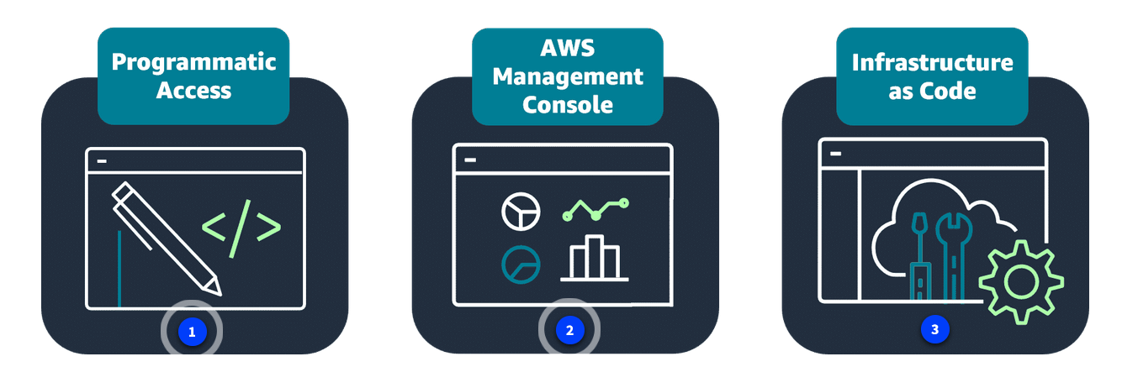
Interacting with AWS resources
As you've learned, there are a number of ways you can operate in the AWS Cloud.
To interact with AWS resources, you must invoke AWS APIs
To interact with these APIs, you can use
  The AWS SDKs.
  The AWS Command Line Interface (AWS CLI)
  The AWS Management Console
  The IaC tools such as CloudFormation.

Slide 23
Programmatic access
Programmatic access includes options like the AWS CLI and AWS SDKs. These options are best suited for developers and those familiar with coding languages.
With the AWS CLI, you manage multiple AWS services directly from the command line. You can automate tasks through scripts.
AWS SDKs can help integrate AWS services into your applications by providing APIs for various programming languages. AWS provides documentation and sample code to help you get started with using SDKs.
Use cases for AWS CLI actions and SDKs include the following:
AWS CLI: Automate routine tasks. For example, you might write a script to provide routine backups for a service such as Amazon Elastic Block Store (Amazon EBS).
SDKs: Invoke APIs for one part of an application process. For example, you might use an SDK to store user data in an AWS storage service such as Amazon Simple Storage Service (Amazon S3).

Slide 24
AWS Management Console
The AWS Management Console is a web interface that you use for managing AWS services, offering quick access to services, search functionality, and simplified workflows.
The console is a great option for those new to the cloud or users with minimal or no development experience.
Use cases for using the console include the following:
  Billing and cost optimization dashboards and visualizations
  Services focused on graphical representations, like Amazon QuickSight and Amazon Neptune

Slide 25
Infrastructure as Code
With IaC tools such as CloudFormation, you can automate resource management across your organization with AWS service integrations offering efficient and repeatable resource creation and management.
Use cases for CloudFormation include the following:
  Managing infrastructure with DevOps such as continuous integration and delivery (CI/CD) pipelines
  Scaling resources such as Amazon EC2 instances to multi-Region applications in a consistent, repeatable way

Slide 26
Amazon CloudFront & CloudFormation

Slide 27
Amazon CloudFront
  Type:
    Content Delivery Network (CDN) service.
  Purpose:
    Delivers content (web pages, images, videos, APIs, etc.) to users with low latency and high transfer speed.
    Uses a global network of edge locations to cache and serve content closer to users.
  Key Benefits:
    Reduced latency – content served from the nearest edge location.
    Improved performance – optimized routing and caching.
    Scalability – automatically handles spikes in traffic.
    Security – integrates with AWS Shield, AWS WAF, and SSL/TLS.
  Use Cases:
    Distributing static content (e.g., images, JavaScript, CSS).
    Streaming videos.
    Accelerating APIs.
    Securing and accelerating websites.

Slide 28
AWS CloudFormation
Type:
  Infrastructure as Code (IaC) service.
Purpose:
  Automates the provisioning and management of AWS resources using templates written in JSON or YAML.
  Ensures consistent and repeatable deployments across environments.
Key Benefits:
  Automation – deploy infrastructure in minutes.
  Consistency – same setup across dev, test, and production.
  Version control – templates can be stored and tracked in source control.
  Easy updates – modify infrastructure by updating the template.
Use Cases:
  Creating and managing multi-tier architectures (e.g., web + database + networking).
  Deploying repeatable environments for testing and production.
  Disaster recovery setups with automated failover.

Slide 29
Recap
In these lessons, you learned more about the AWS Global Infrastructure.
You learned about choosing a Region, the value of edge locations, and how to use services such as CloudFormation to streamline and automate deployment.

Slide 30
Resources
Resource link | Description
AWS Global Infrastructure | Learn more about the AWS Global Infrastructure.
AWS for the Edge | Learn more about AWS edge locations and edge networking.
AWS CloudFormation | Learn more about the infrastructure as code service, CloudFormation.

